Slide 1
Intro

Slide 2
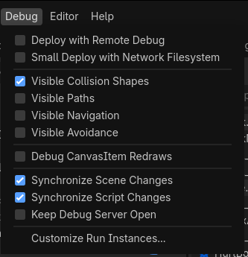
Prerequisite
Visible collision shapes
Some familiarity with the engine

Slide 3
Decide witch attack
(see input system video)

Slide 4
Decide witch attack
(see input system video)
Start_attack “attack”

Slide 5
Decide witch attack
(see input system video)
Start_attack “attack”
Attack manger

Slide 6
Decide witch attack
(see input system video)
Start_attack “attack”
Attack manger
Attack

Slide 7
Decide witch attack
(see input system video)
Start_attack “attack”
Attack manger
Attack
Frame

Slide 8
Decide witch attack
(see input system video)
Start_attack “attack”
Attack manger
Attack
Frame
Hit / Hurt boxes

Slide 9
Decide witch attack
(see input system video)
Start_attack “attack”
Attack manger
Attack
Frame
Hit / Hurt boxes
Collision Shapes

Slide 10
Attack layer

Slide 11
notes
to start the an attack, attack manger would be told what to start it would then save it and run though it telling each of the nodes below it what it should do

Slide 12
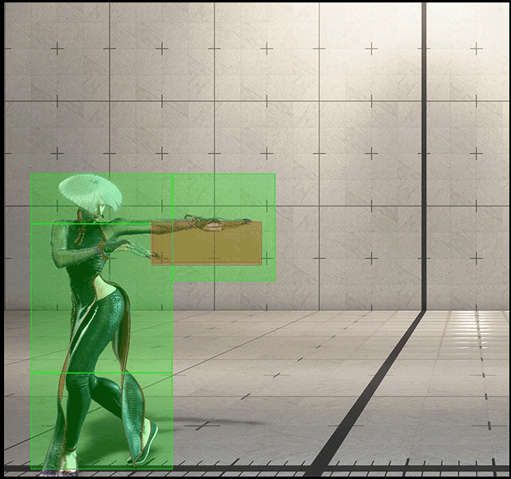
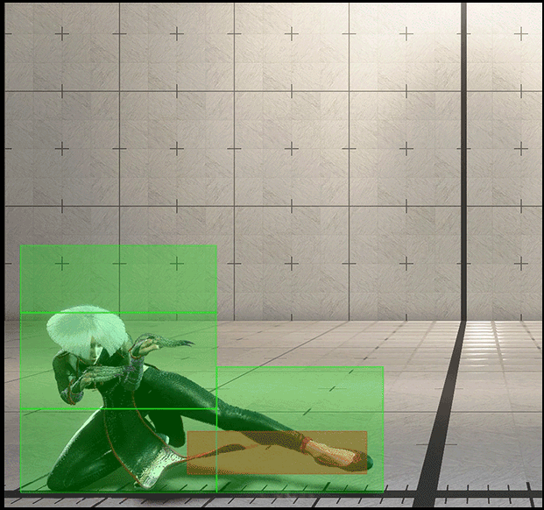
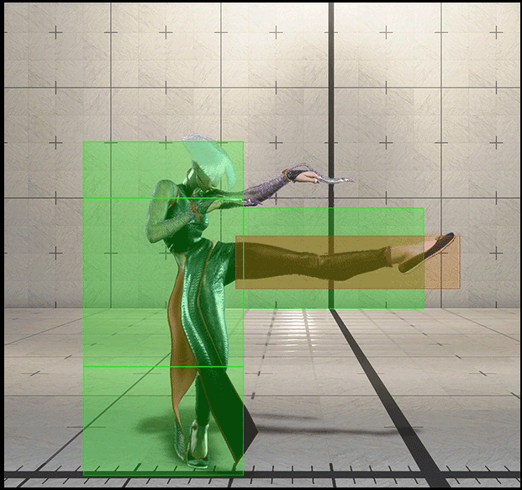
Attack manger
start_attack “attack”
Attack
... ... ... ...
Frame
Hit / Hurt boxes
Collision Shapes

Slide 13
Attack manger
start_attack “5 LP”
Attack
... ... ... ...
Frame
Hit / Hurt boxes
Collision Shapes

Slide 14
Attack manger
start_attack “5 LP”
Attack
... ... ... ...
Frame
Hit / Hurt boxes
Collision Shapes

Slide 15
Frame layer

Slide 16
notes
Each attack has many frames
The attack node would track witch frame we are on and the frames would update accordingly by enableing and disableing the shapes below it

Slide 17
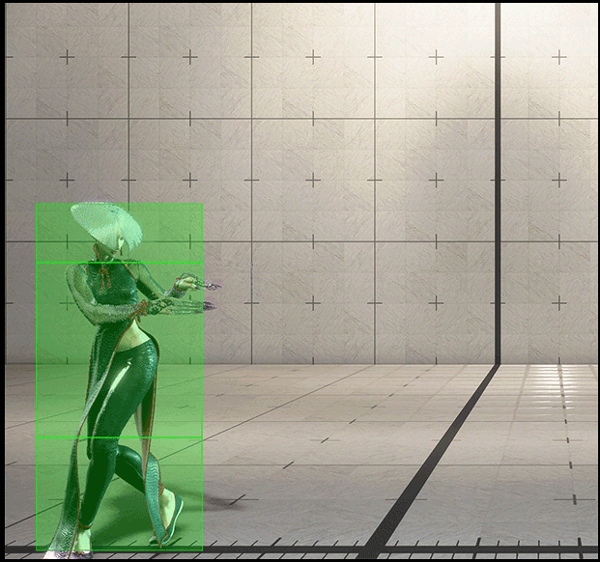
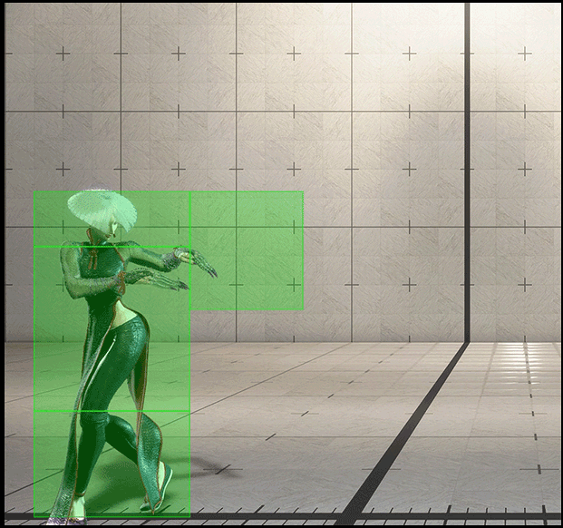
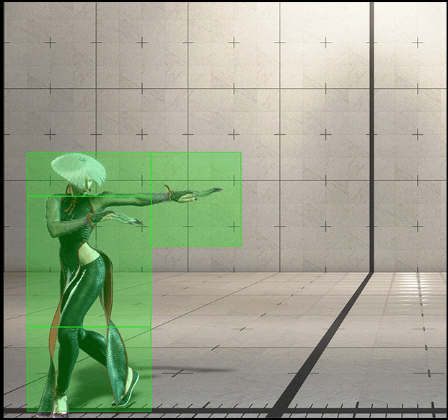
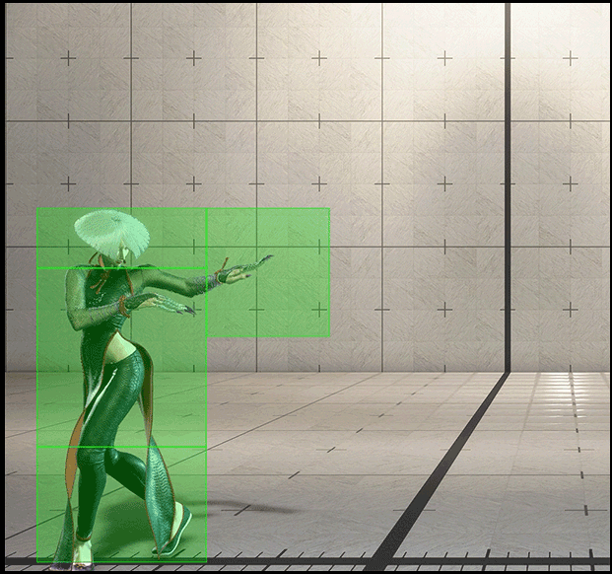
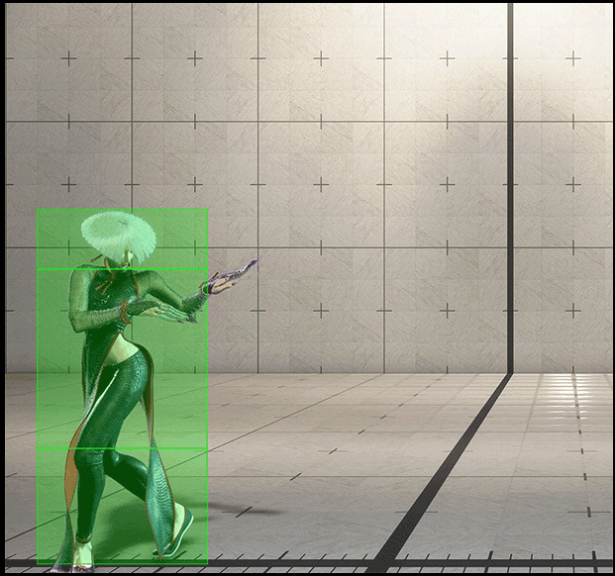


Frame layer
Attack manger
Attack
Frame
Hit / Hurt boxes
Collision Shapes

Slide 18
Frame layer
Attack manger
Attack
Frame
Hit / Hurt boxes
Collision Shapes

Slide 19
Frame layer
Attack manger
Attack
Frame
Hit / Hurt boxes
Collision Shapes

Slide 20
Frame layer
Attack manger
Attack
Frame
Hit / Hurt boxes
Collision Shapes

Slide 21
Frame layer
Attack manger
Attack
Frame
Hit / Hurt boxes
Collision Shapes

Slide 22
Frame layer
Attack manger
Attack
Frame
Hit / Hurt boxes
Collision Shapes

Slide 23
Frame layer
Attack manger
Attack
Frame
Hit / Hurt boxes
Collision Shapes

Slide 24
Frame layer
Attack manger
Attack
Frame
Hit / Hurt boxes
Collision Shapes

Slide 25
Frame layer
Attack manger
Attack
Frame
Hit / Hurt boxes
Collision Shapes

Slide 26
Hit/ Hurt box and shape layer

Slide 27
Notes
Hitbox would tell when it hit something and the shapes make the shape of the attack
Hurtbox is mostly just their to be detected

Slide 28
Attack manger
Attack
Frame
Hit / Hurt boxes
Collision Shapes

Slide 29
Attack manger
Attack
I hit something tell everyone
Frame
Hit / Hurt boxes
Collision Shapes

Slide 30
Attack manger
Attack
I hit something tell everyone it is this “entity and block state”
Frame
Hit / Hurt boxes
Hit / Hurt boxes
I hit something tell everyone it is this with this attack data.
Collision Shapes

Slide 31
Start in code and godot

Slide 32
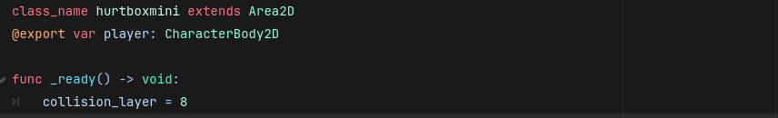
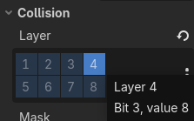
Notes:
We can start with just defining each of the classes and since the hurt box is a ver short and simple scipt that is more for detection than for it doing anything independently we can put in the ready function to set the collision layer to what fits your project I’ve set it to a value of 8 witch corresponds to layer 4

Slide 33
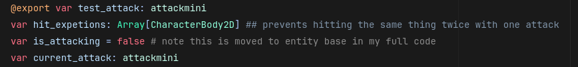
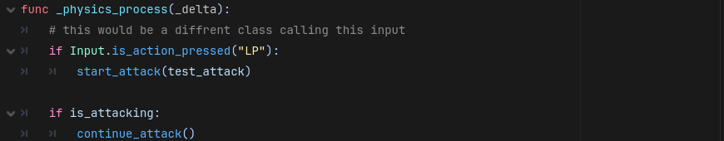
Notes:
We will add as we contiue thogh to contiue attack

Slide 34
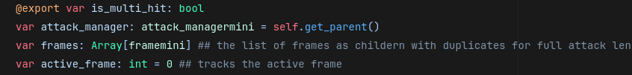
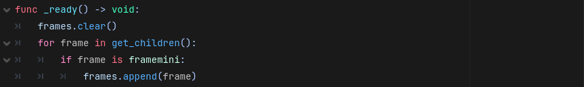
Notes:
The self. Get parent is not the best thing to do normally in code as if you misplace the nodes in the scene tree you will get errors. So be careful with the nodes. I do for 2 reasons 1 I don’t know a better automatic solution and 2 this is to follow the tree structure i built and in my full code i have helper functions to make sure i don’t break the tree but those aren’t the focus. If you have a better way comment it below after I show you more code to critisize

Slide 35
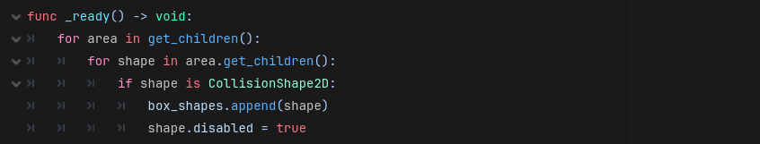

Slide 36
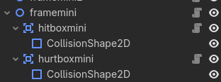

Slide 41
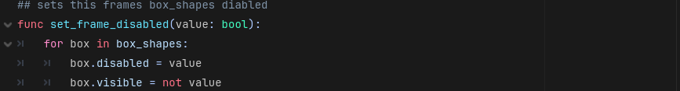

Slide 42


Slide 43
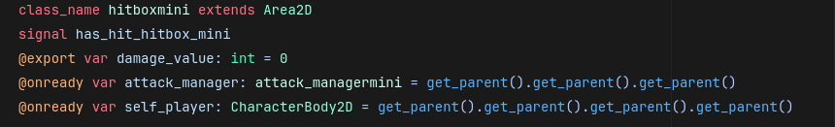
4
3
2
1
player
Attack manger
Attack
Frame
Hit / Hurt boxes
Collision Shapes

Slide 45
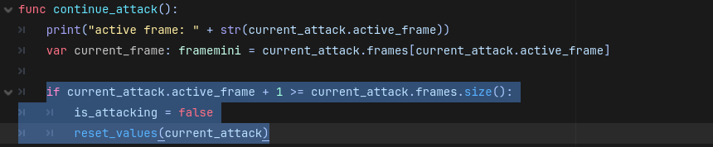

Slide 46
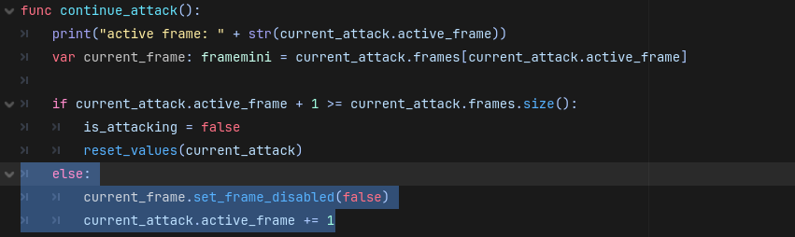

Slide 47
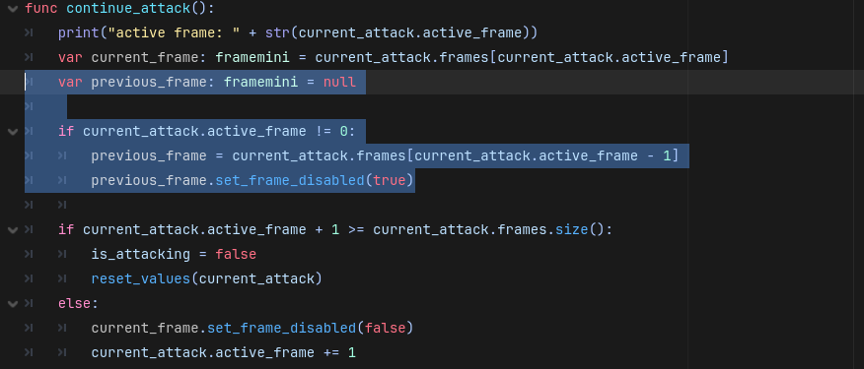

Slide 48
Input before testing
Make sure you have an input and it is set in the input map
Make sure it matches in code if you were following along our test button is here in attack manager mini as LP

Slide 49
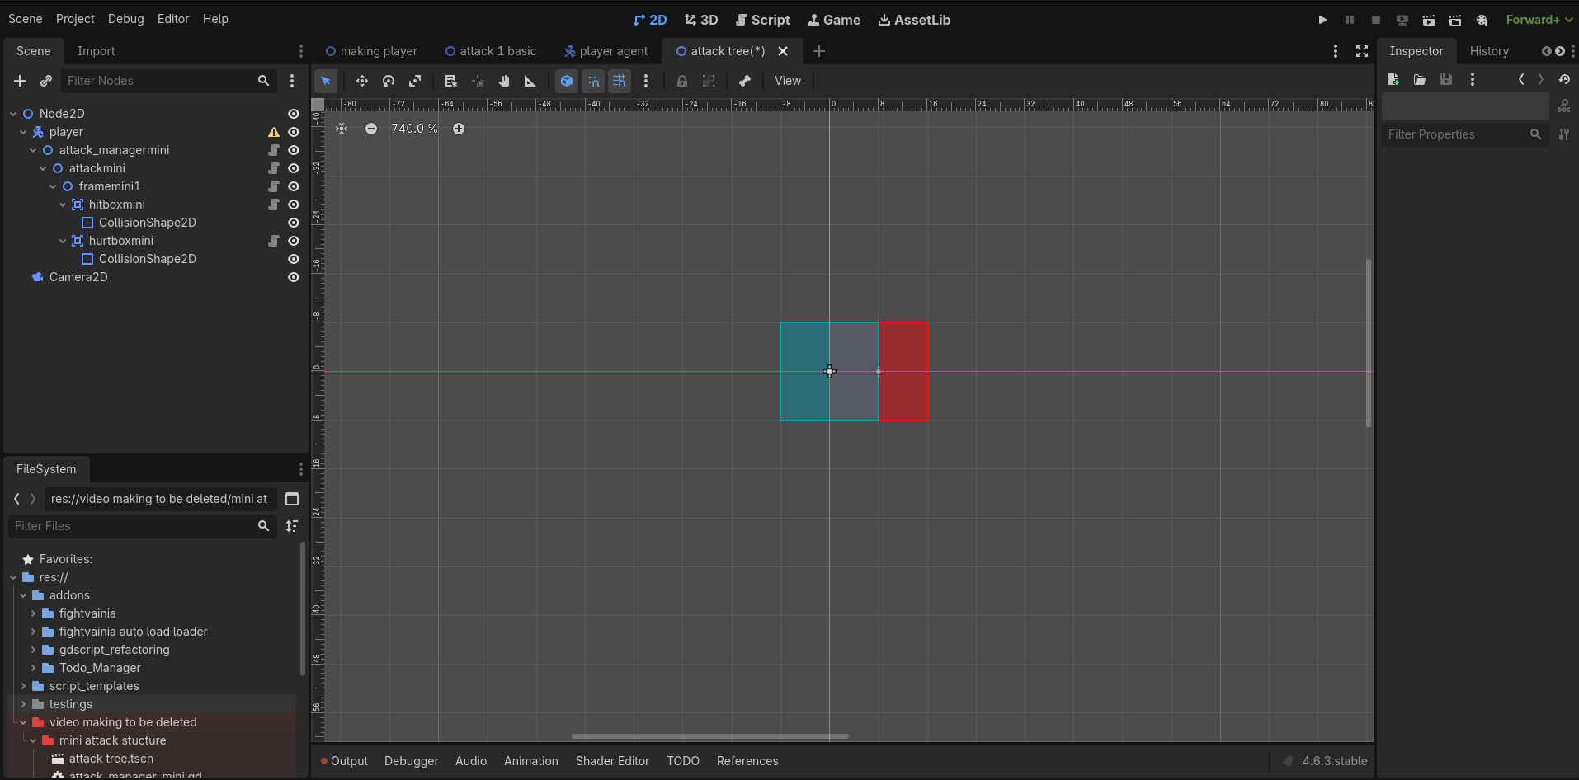
Lets test build this scene ill wait 5 seconds to for you to pause colour of the shapes is for clarity
Notes:
First lets build out scene and try on the right is the red hit-box on the left is the blue hurt box the colours are for clarity

Slide 50
What is the issue in the output
Damage was called when it shouldn’t be.
Array over flow error
Null error
Its fine no issues

Slide 51
Comment after quiz
If you get any of the errors go back and check over your code again and make sure its bug free here is the full scripts so far

Slide 52
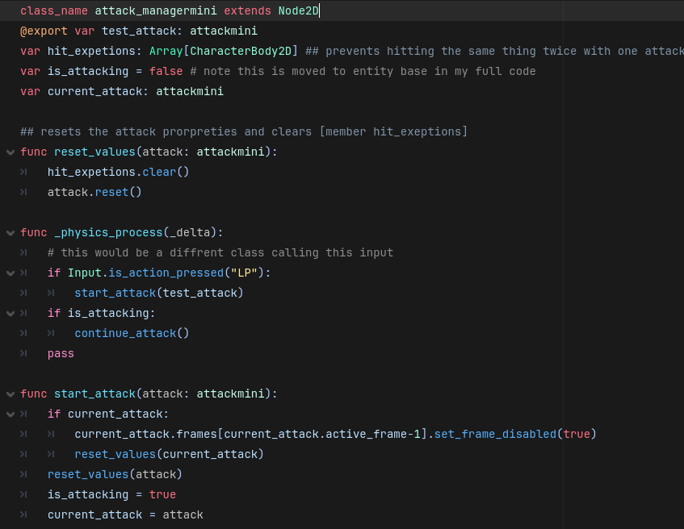
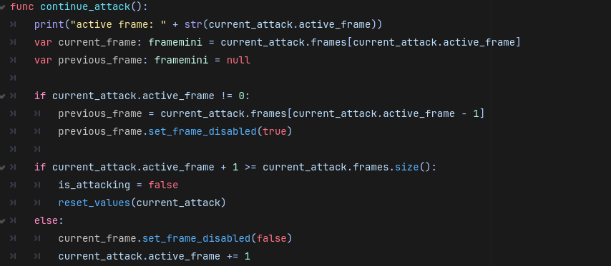
Attack manager

Slide 53
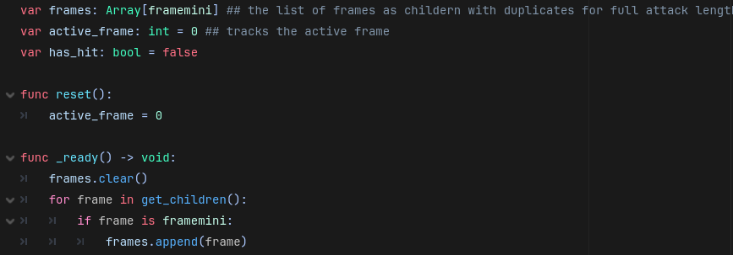
attack

Slide 54
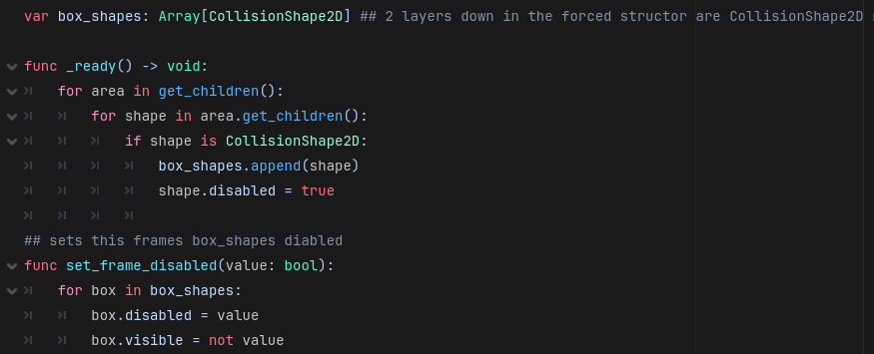
frame

Slide 55
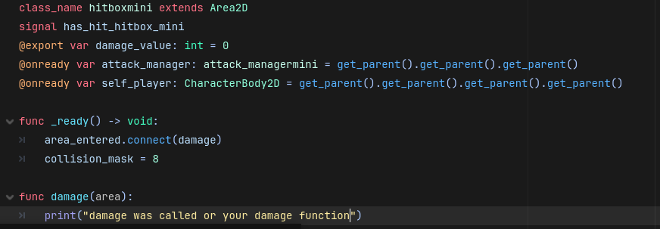
Hit box

Slide 56
Hurt box
Notes:
We can start with just defining each of the classes and since the hurt box is a ver short and simple scipt that is more for detection than for it doing anything independently we can put in the ready function to set the collision layer to what fits your project I’ve set it to a value of 8 witch corresponds to layer 4

Slide 57
So what happened
We made an attack with both a Hitbox and Hurtbox so it hit its self.
This means we need to have self hit prevention if we want things to overlap

Slide 58
Adding self hit protection

Slide 59
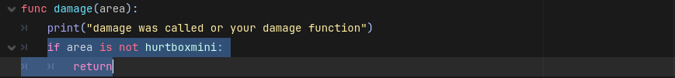

Slide 60
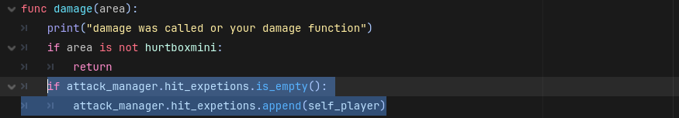

Slide 61
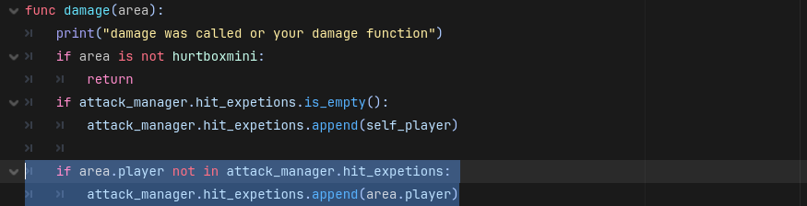

Slide 62
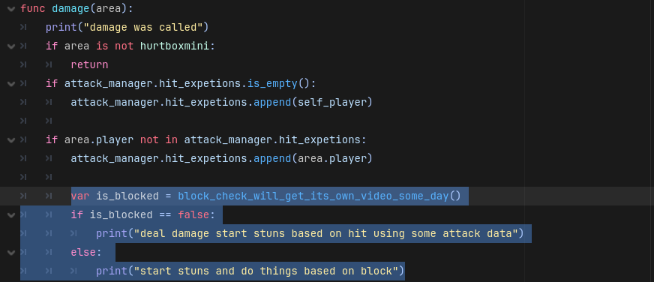

Slide 63
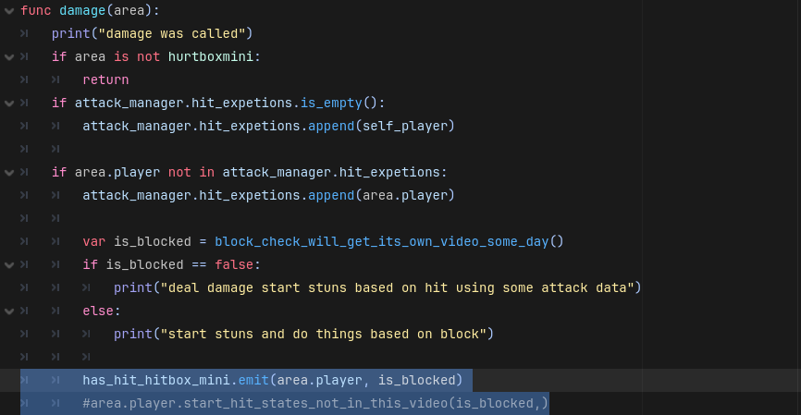

Slide 65
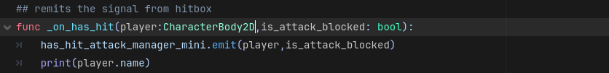

Slide 66
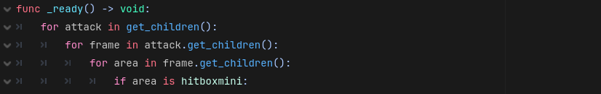
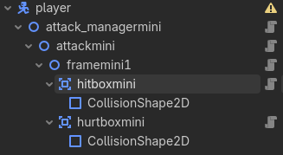

Slide 71
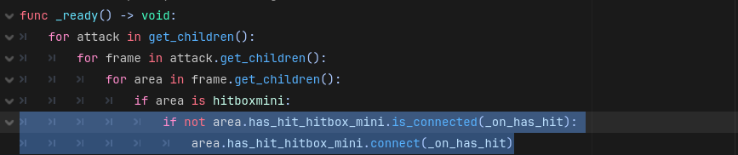

Slide 72
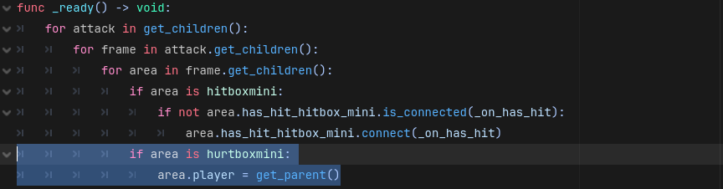

Slide 73
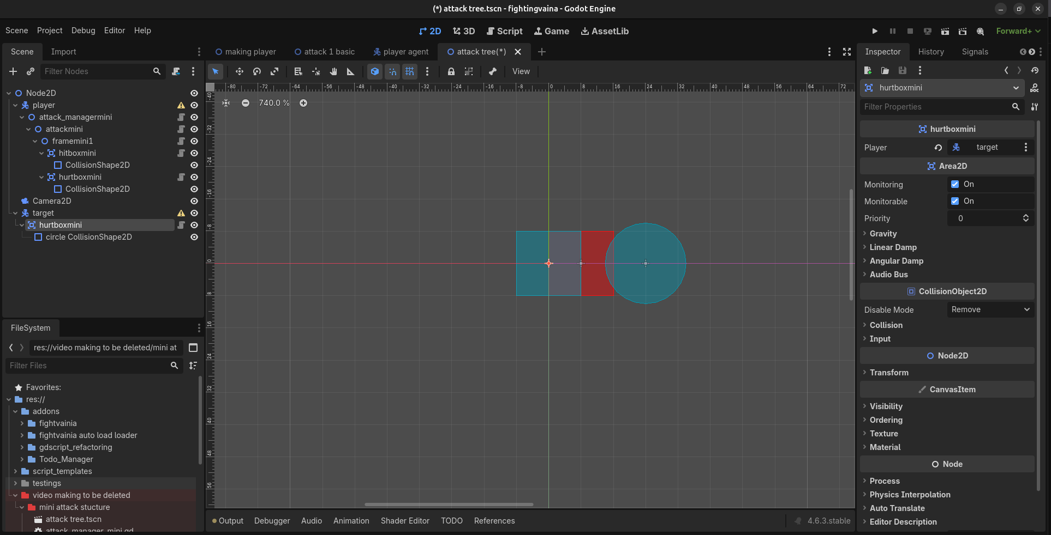
Lets test again Make this scene or add to the previous

Slide 74
Lets test again Make this scene or add to the previous

Slide 75
When you attack is what the expected output
Both player and target’s names are printed
only player’s name is printed
Only target’s name is printed.
An error

Slide 76
Whats left for video 1
So far we only used one frame and as such we still need to test and try with more then one frame
Its also really annoying to add or remove frame per frame for testing
To prevent unwanted behaviour start attack needs attack resetting and maybe some other conditions

Slide 77
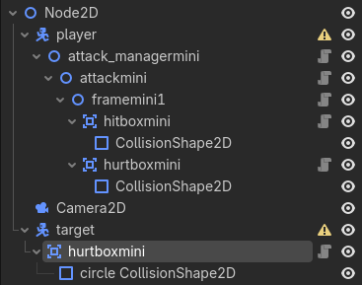
We only have 1 frame that represents exactly 1 frame

Slide 78
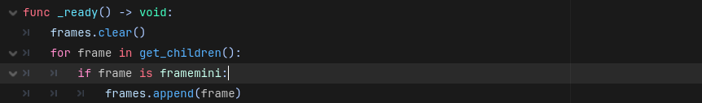

Slide 79
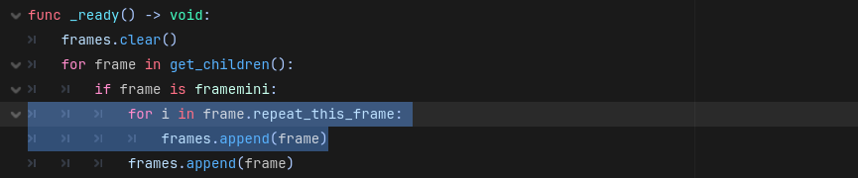

Slide 80
1+1
1
1+4

Slide 82
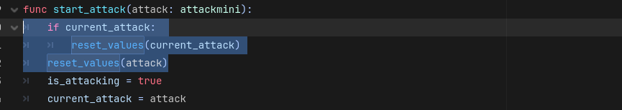

Slide 83
bounus

Slide 84
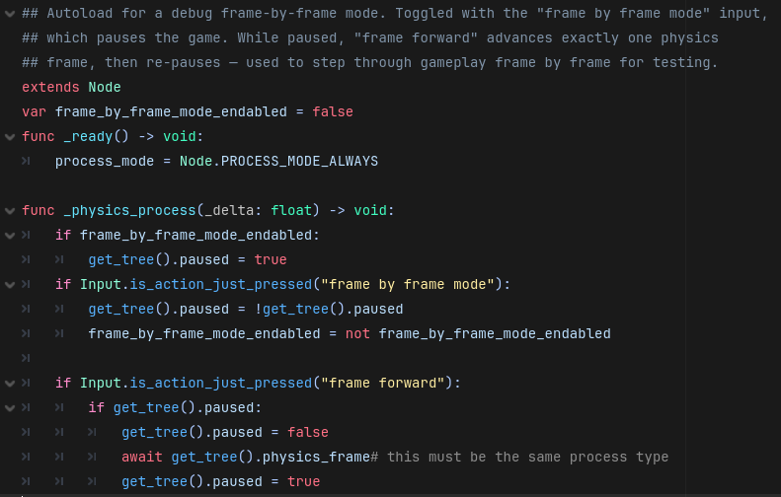
Frame by frame mode tool

Slide 85
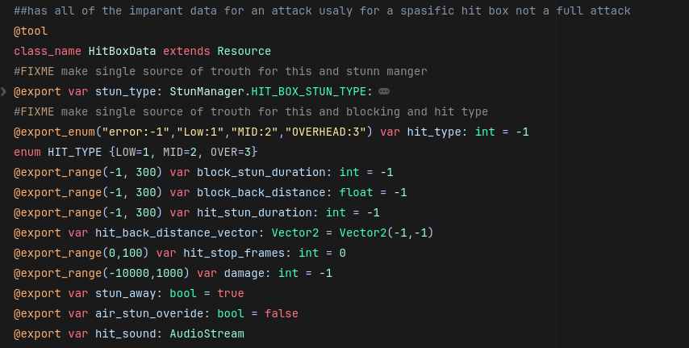
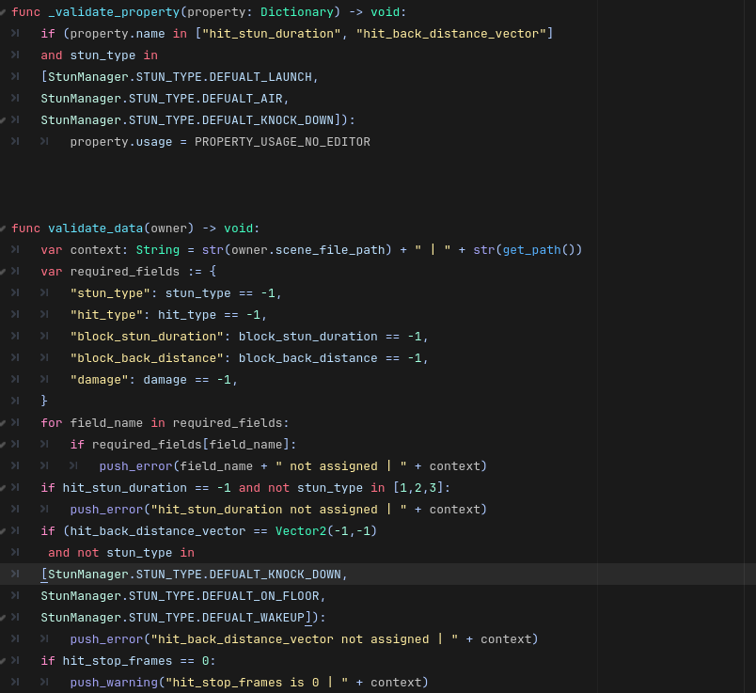
Attack data

Slide 86
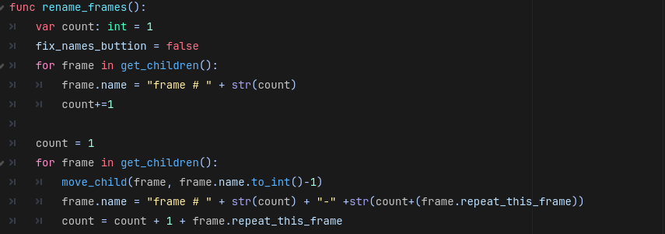
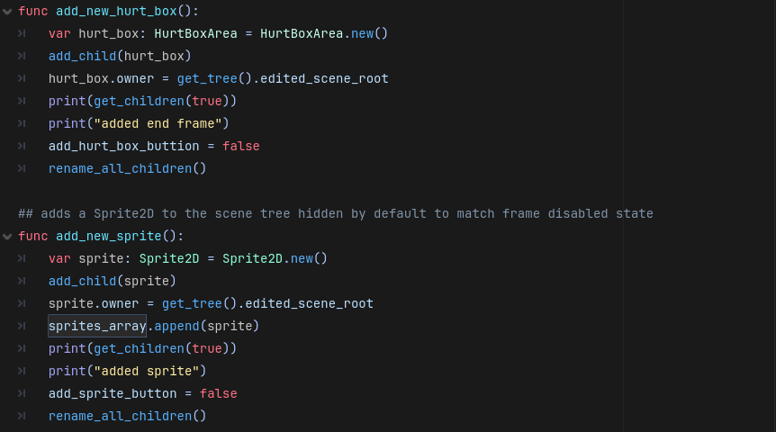
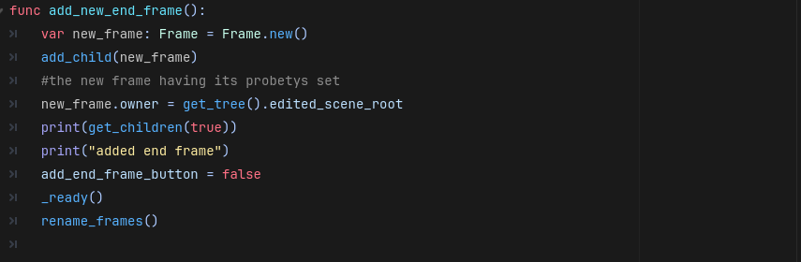

Slide 87
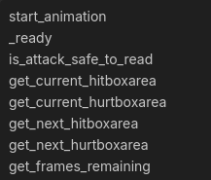
helper functions

Slide 88
after main video
What data may look like
My helper functions in each class

